Slide 1

ACTIVITY 1
10 MIN
STUDENT
ENROLMENT
COURSE
Student ID | Student Name | Date of birth | Province
1001 | Mengyi | xxx | xxx
1002 | Tim | xxx | xxx
1003 | Narong | xxx | xxx
1004 | Nork | xxx | xxx
1005 | Sophim | xxx | xxx
Enrolment ID | Student ID | Course ID
10011001 | 1001 | 1002
10021002 | 1002 | 1002
10031002 | 1003 | 1002
10031001 | 1003 | 1001
10041001 | 1004 | 1001
10051001 | 1005 | 1001
10011004 | 1001 | 1004
10021004 | 1002 | 1004
Course ID | Course name | Teacher | Department
1001 | JavaScript | Clément | WEP
1002 | Oral comprehension | Sokhom | English
1003 | Algorithm | Ronan | WEP
1004 | Drawing | Him | Art
What courses follows Mengyi?
Who are the students that follow the Javascript course?
How many students follow the Drawing course?
Notes:
Complete the tables with examples

Slide 2
ACTIVITY 2
10 MIN
PARENT
parent_id gender last_name job_name
STUDENT_PARENT
parent_id student_id
STUDENT
student_id gender last_name shool_name
1
many
many
1
What is the relation between Students and Parents?
The table Student_Parents is called an Intersection table or an Associative table or is it just a normal table? Explain why.

Slide 3
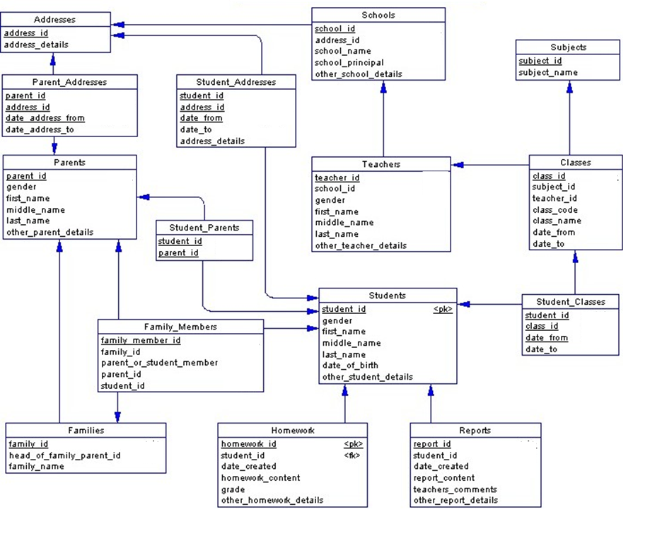
ACTIVITY 3
10 MIN
Complete the model to precise for each id if they are a Primary Key (PK) or a Foreign Key (FK)
EXAMPLE
PK
PK FK
PK
FK
PK
PK
PK
PK
PK
PK
PK
PK
PK
PK

Slide 4
ACTIVITY 4
10 MIN
STUDENT
student_id gender name province
STUDENT
student_id(Numberic) coure_id(Numberic)
COURSE
coure_id course_name departement
FK
Intercession key
Add a new table to manage the MANY to MANY relation ship
For each attribute, write the TYPE and for the keys, specify PK or FK

